Slide 1

COM4510/6510
Software Development for Mobile Devices
Lecture 9: Contextualising user Actions
Dr Po Yang
The University of Sheffield
po.yang@sheffield.ac.uk

Slide 2
Lecture Overview
Part 1:
• Contextualising
• Geofencing
• Part 2:
Activity Recognition
Combining AR and Geofencing
• Lab tutorial :
•Preparing assignments

Slide 3
IMPORTANT NOTE
GIVEN THE RESTRICTIONS ON THE USE OF GOOGLE MAPS
it is required that the package is declared in the Android Developer console for every application you develop
even for debugging
So, in your assignment you can either use the package
uk.ac.shef.oak.com4510
uk.ac.shef.oak.com6510
or in case of emergency you can ask me to add your own package (please do not - there are too many of you!)

Slide 4
Contextualising
Phones are with us 24/7
The context influences the services we can provide, e.g.:
users must not receive telephone calls when we are driving unless using a hands free device
users may receive specific services based on specific locations
e.g. task reminders when in the appropriate area

Slide 5


Contextual computing
© Fabio Ciravegna, University of Sheffield
What is important here is the idea, not the actual product (which failed from a commercial point of view btw)

Slide 6
Geofencing
Context based on locations

Slide 7
Geofences
https://developer.android.com/training/location/geofencing
Geofencing combines awareness of the user's current location
with awareness of the user's proximity to locations that may be of interest
specified via latitude and longitude
A radius is added to allow for imprecision in detection
or simply to support proximity rather than matching
The latitude, longitude, and radius define a geofence, creating a circular area, or fence, around the location of interest

Slide 8
You can have multiple active geofences, Max 100 per user
For each geofence Location Services can send entrance and exit events
dwell time before event triggering can be specified
duration of any geofence can be specified in milliseconds (if useful)
Note: geofences are fine with battery power - they balance precision for a progressive use of power

Slide 9
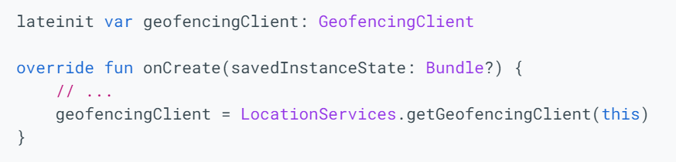
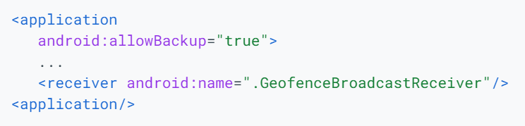
Requesting permissions
You will need:
Add the permissions to the Android manifest.
Access the location APIs, you need to create an instance of the Geofencing client
If you want to use a BroadcastReceiver to listen for geofence transition

Slide 10
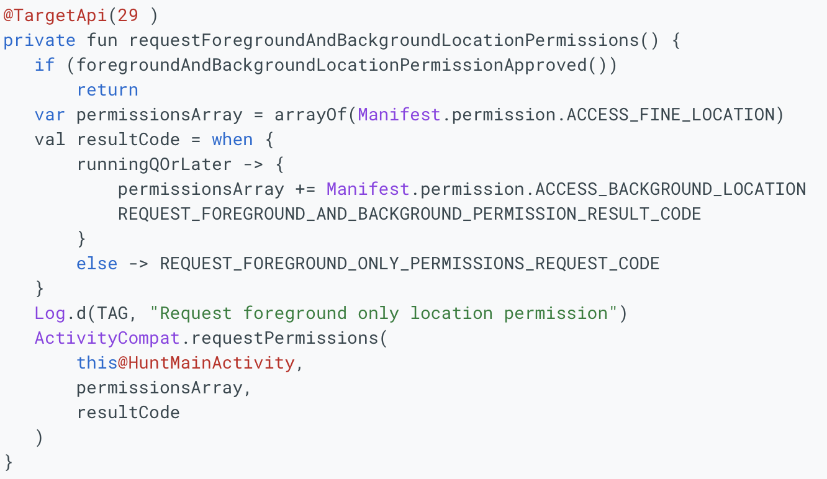
Requesting permissions
You will need:
Request those permissions by calling that method.

Slide 11
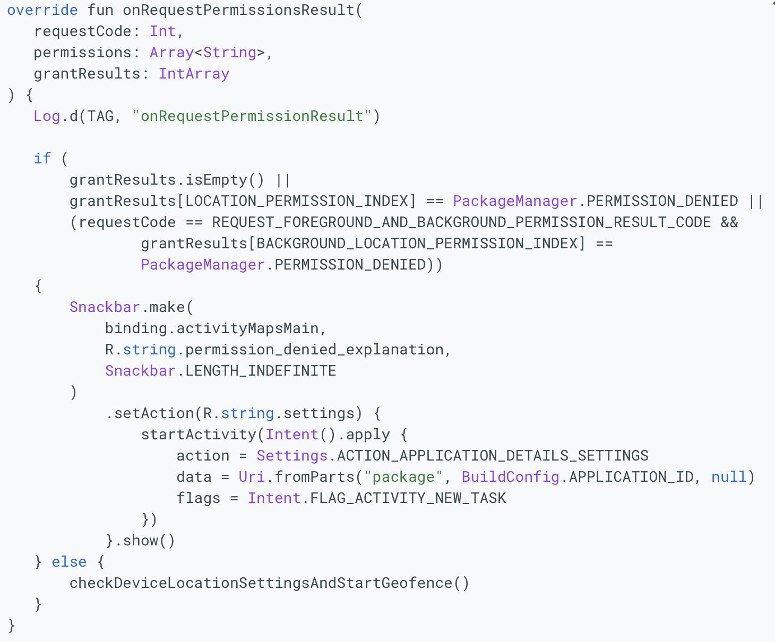
Requesting permissions
You will need:
Handle the result of asking the user for the permissions.

Slide 12
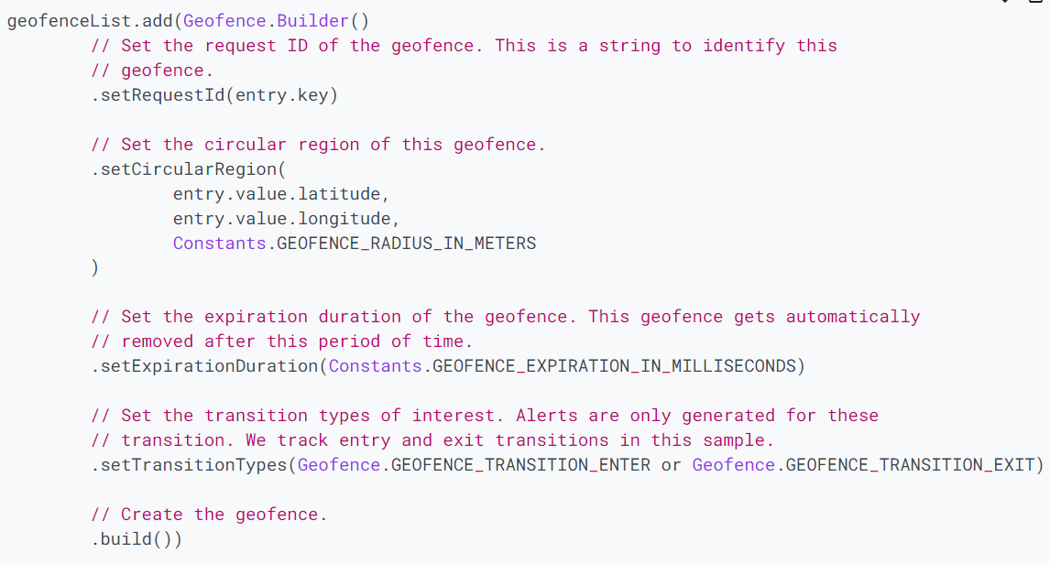
Create geofence objects
create a geofence, setting the desired radius, duration, and transition types for the geofence. For example, to populate a list object:

Slide 13
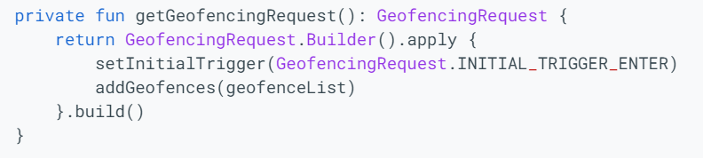
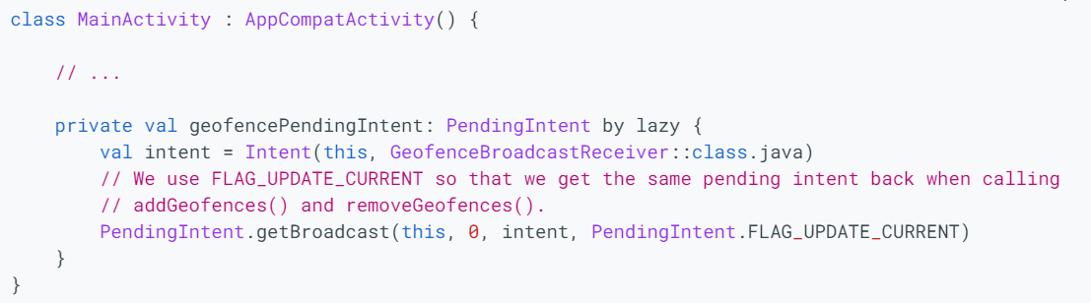
Specify geofences and initial triggers
Specify geofences and initial triggers, the use of two geofence triggers.
Define a broadcast receiver for geofence transitions

Slide 14
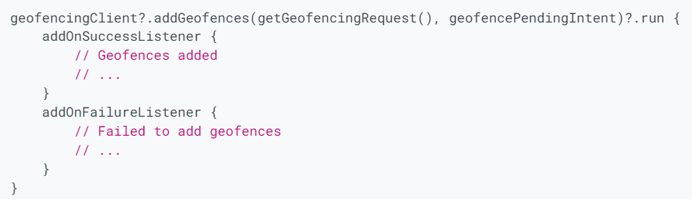
Add geofences
To add geofence, use the addGeofences() method, and the PendingIntent.

Slide 15
PendingIntent
A PendingIntent is a token that you give to a foreign application
e.g. NotificationManager , AlarmManager , Home Screen AppWidgetManager , or other 3rd party applications
to allow the foreign application to use your application's permissions to execute a predefined piece of code that you provide

Slide 16
PendingIntent
By giving a PendingIntent to another application, you are granting it the right to perform the operation you have specified as if the other application was yourself
with the same permissions and identity
Be careful about how you build the PendingIntent:
almost always, for example, the base Intent you supply should have the component name explicitly set to one of your own components, to ensure it is ultimately sent there and nowhere else

Slide 17
Creating a request
GEOFENCE_TRANSITION_ENTER triggers when a device enters a geofence,
GEOFENCE_TRANSITION_EXIT triggers when a device exits a geofence
INITIAL_TRIGGER_ENTER tells Location services that
GEOFENCE_TRANSITION_ENTER should be triggered if the device is already inside the geofence
INITIAL_TRIGGER_DWELL triggers events only when the user stops for a defined duration within a geofence
reduce "alert spam" resulting from large numbers notifications when a device briefly enters and exits geofences

Slide 18
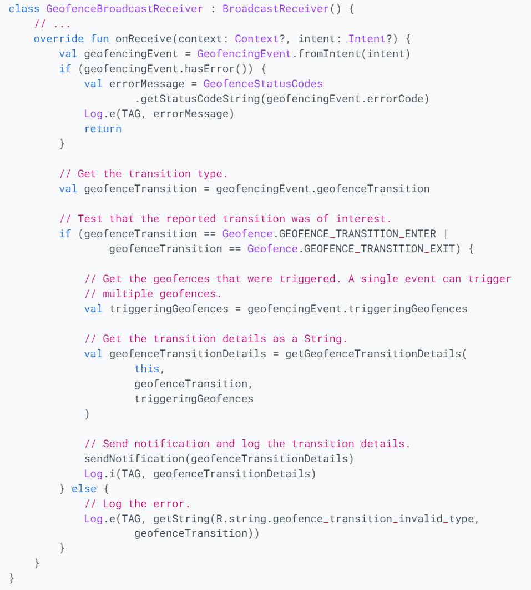
Handle geofence transitions
When location services detect that the user has entered or exited a geofence, it send out the intent

Slide 19
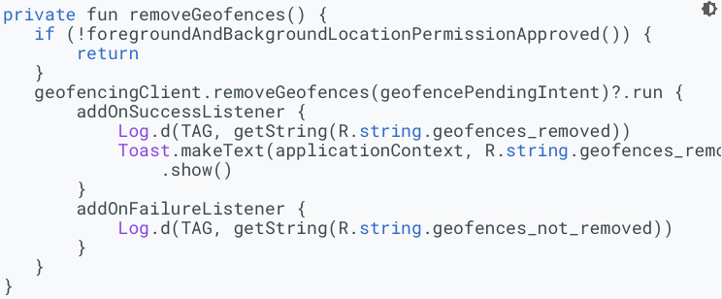
Removing Geofences
When you no longer need geofences, it is a best practice to remove them, which stops monitoring, in order to save battery and CPU cycles.

Slide 20
Best practices
Reduce power consumption
Set the notification responsiveness to a higher value to avoid false alarms
Use a larger geofence radius
for locations where a user spends a significant amount of time, such as home or work
to avoid false enter/exit events
for indoor locations (esp tall buildings)
Choose the optimal radius for your geofence
100m suggested in city - some km in the middle of nowhere

Slide 21
Activity Recognition
Context based on Actions

Slide 22
A/R
https://developer.android.com/guide/topics/location/transitions
It might be necessary to design your app to identify when a user starts or stops a particular activity
e.g., biking, or driving
Why?
e.g. a mileage tracking app could start tracking miles when a user starts driving,
a messaging app could mute all conversations until the user stops driving
The Activity Recognition Transition API detects changes in the user's activity
Apps subscribe to transitions in activities of interest and the API notifies your app only when needed

Slide 23
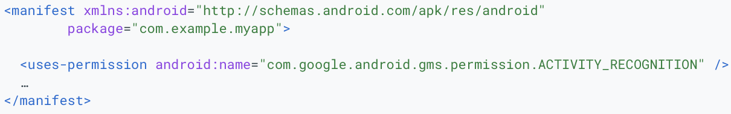
How to
Permissions
You must implement the following:
An ActivityTransitionRequest object that specifies the type of activity and transition
A PendingIntent callback where your app receives notifications

Slide 24
Activities
Constants in the DetectedActivity class
The Transition API supports the following activities:
IN_VEHICLE
ON_BICYCLE
RUNNING
STILL
WALKING
A transition type of ACTIVITY_TRANSITION_ENTER or ACTIVITY_TRANSITION_EXIT. For more information, refer to the ActivityTransition class.

Slide 25
ActivityTransitionRequest
To create the ActivityTransitionRequest object, you must create
a list ofActivityTransition objects, which represent the transition that you want to receive notifications about
An ActivityTransition object includes the following data:
An activity type (e.g. Walking)
A transition type: ACTIVITY_TRANSITION_ENTER or ACTIVITY_TRANSITION_EXIT

Slide 26
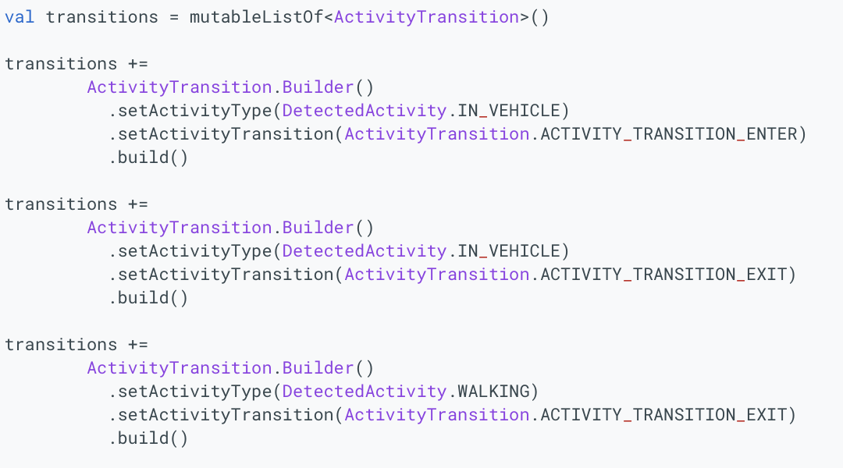
Example
Then create a request

Slide 27
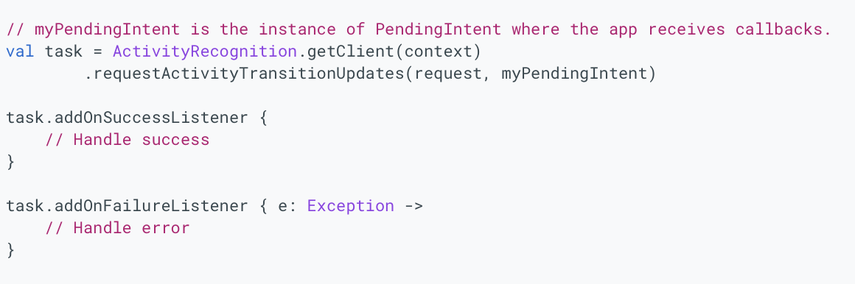
Create a Task and pass an intent
then define what to do if the request fails/succeed

Slide 28
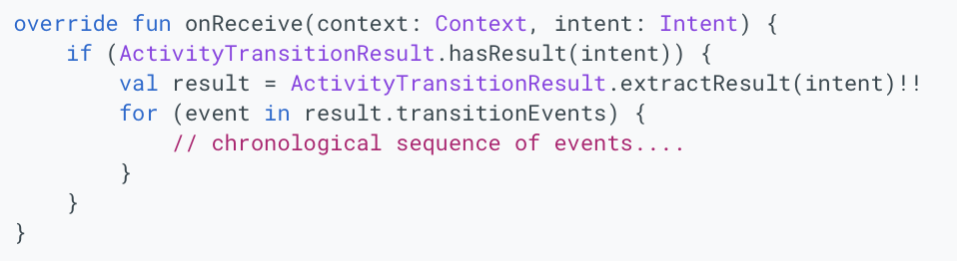
Process activity transition events
When the requested activity transition occurs, you app receives an Intent callback. An ActivityTransitionResult object can be extracted from the Intent, which includes a list of ActivityTransitionEvent objects.
The events are ordered in chronological order, for example, if an app requests for the IN_VEHICLE activity type on the ACTIVITY_TRANSITION_ENTER and ACTIVITY_TRANSITION_EXIT transitions, then it receives an ActivityTransitionEvent object when the user starts driving, and another one when the user transitions to any other activity.
You can implement your callback by creating a subclass of BroadcastReceiver and implementing the onReceive() method to get the list of activity transition events.

Slide 29
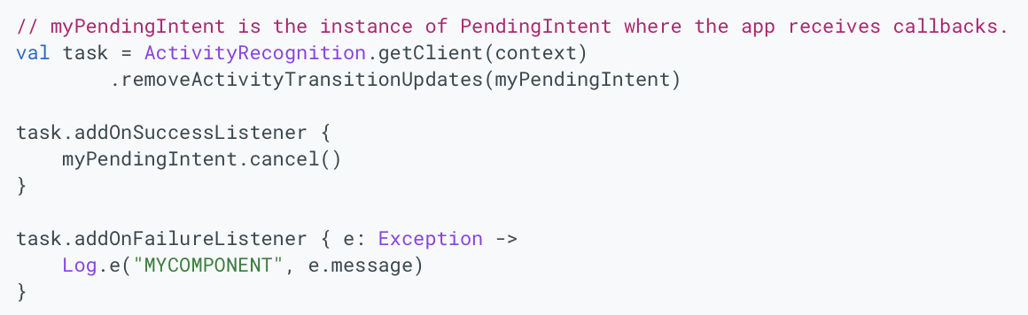
Deregister for activity transition updates
You can deregister for activity transition updates by calling the removeActivityTransitionUpdates() method of the ActivityRecognitionClient and passing your PendingIntent object as a parameter:

Slide 30
Combining the two

Slide 31
Applications
With A/R and geofencing you can create cool apps that for example
Tracking detailed locations only in some contexts, e.g.
MOTOR INSURANCE: tracking locations only when driving
HOW?
Set up A/R in your app
Create a background service tracking the locations using HIGH_ACCURACY
start A/R
when the transition IN_VEHICLE ENTER is detected, start tracking locations
when the transition IN_VEHICLE EXIT is detected, stop tracking locations

Slide 32
Tracking location of employees on large sites (e.g. steelworks)
This is allowed for some specific cases only (e.g. safety)
You must track only when on site, not when they are at home
How?
Set a geofence around the site
When the user enters the site, start tracking locations
Note it only works for very large sites as location tracking not very good indoors

Slide 33
Tracking your employees only when they are driving for work
How?
set a geofence around your company site
set A/R on the app
when the user is driving and has just left the geofence, start tracking

Slide 34
Create a tourist’s app
When the user has entered your site and is no longer driving, provide suggestions and informations
How?
set a geofence around your site
detect transition IN_VEHICLE and Exit
When user is on site and has stopped driving, provide the information

Slide 35
No longer office machines

Slide 36
The tip of the iceberg
Phones are not computers
They have far better capabilities and possibilities
Only issue is battery power
It has been a long journey from the office machines

Slide 37

No longer office machines

Slide 38
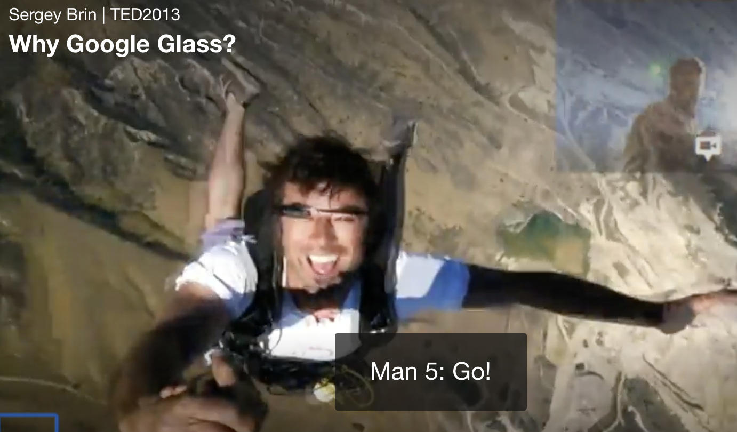
In my Eyes
https://www.ted.com/talks/sergey_brin_why_google_glass?language=en#t-47041

Slide 39
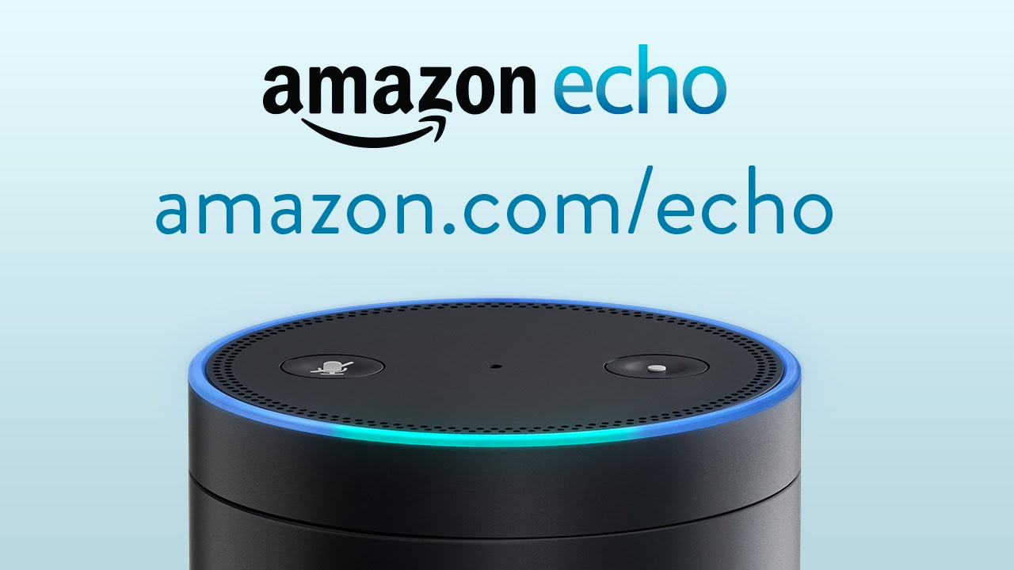
In my home

Slide 40
Testing

Slide 41
Complex
Difficult
Lengthy
Requires
Junit testing
Testing on real devices
Tests on different Android Version x devices
Independent testers

Slide 42
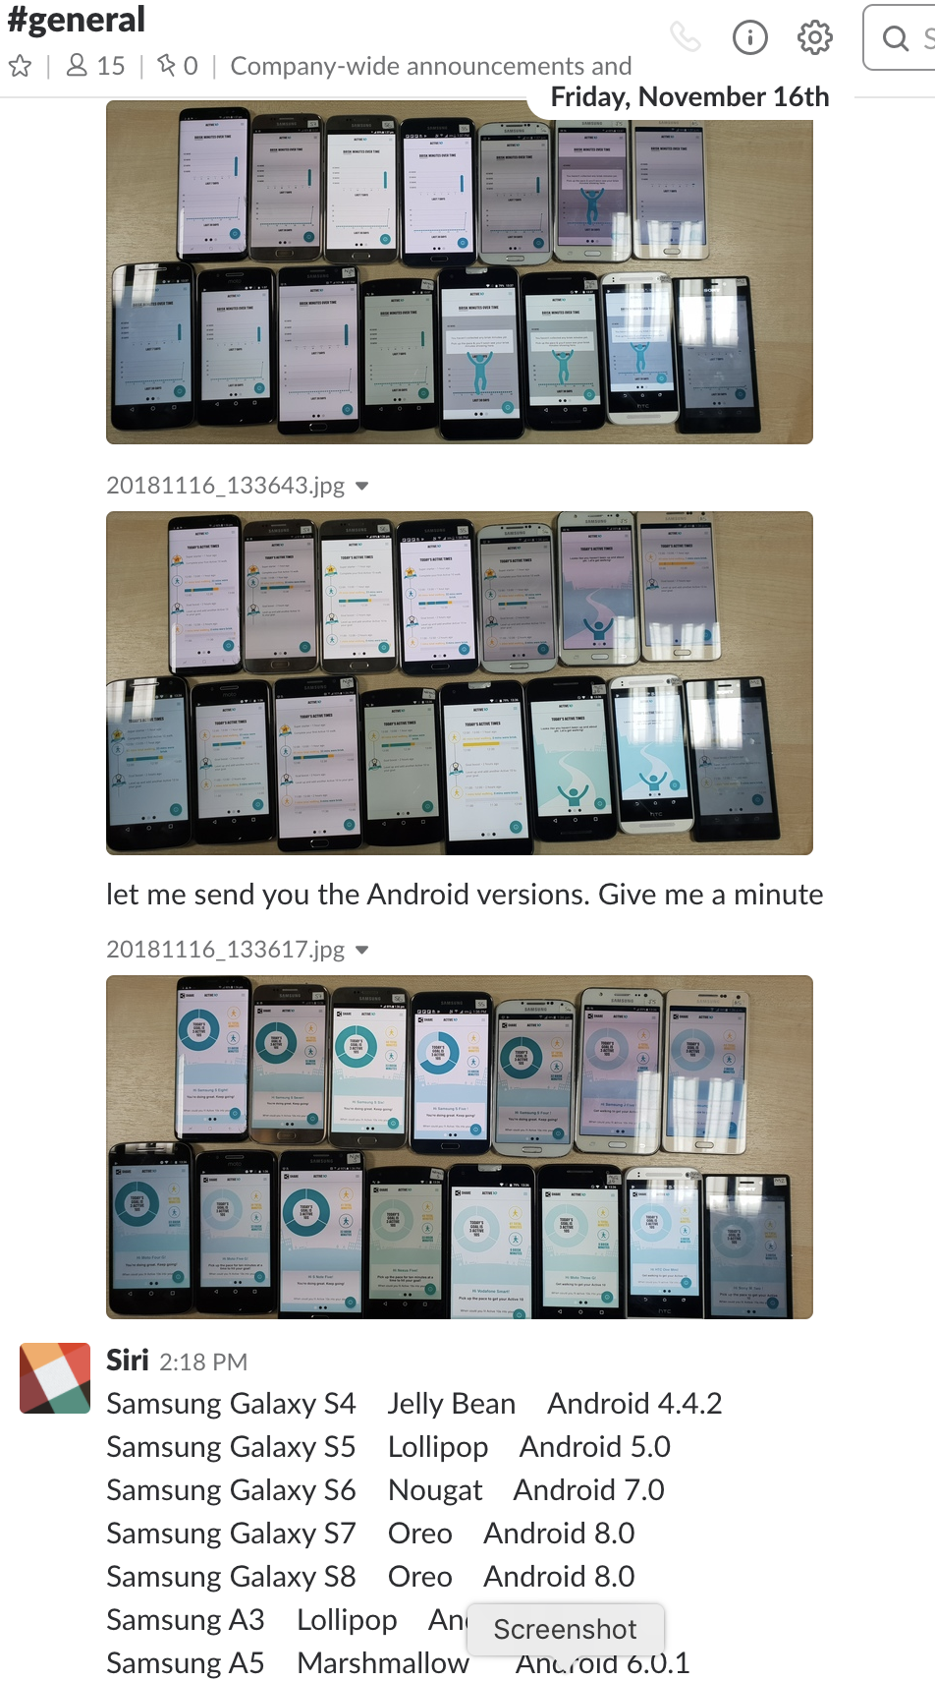

Slide 43
Summary
Part 1:
• Contextualising
• Geofencing
• Part 2:
Activity Recognition
Combining AR and Geofencing
• Lab tutorial :
•Preparing assignments

